Slide 1


Jenkins Master Slave Configuration

Slide 2
What is Jenkins ?
Jenkins – an open source automation server which enables developers around the world to reliably build, test, and deploy their software.
what is Jenkins master slave configuration :
Jenkins is an awesome Continuous Integration tool which allows you to add multiple slaves as per your project requirement to a central Master server. In distributed environment, we need different machines for different purposes.

Slide 3
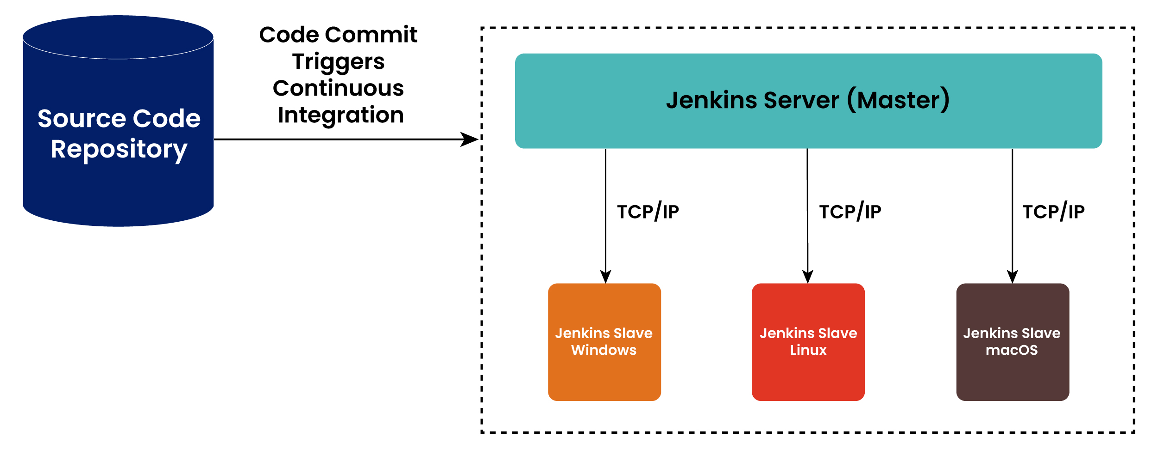
What is Jenkins master slave architecture
The Jenkins master acts to schedule the jobs, assign slaves and send builds to execute the job.
It will also monitor the slave state and get back the build result responses from slaves and display build results on console output

Slide 4
Configure Jenkins Slave Node :
Create user, ssh keys and copy it to authorized_keys.
sudo useradd jenkins-slave1
sudo su - jenkins-slave1
ssh-keygen -t rsa -N "" -f /home/jenkins-slave1/.ssh/id_rsa
cd .ssh
cat id_rsa.pub > authorized_keys
chmod 700 authorized_keys

Slide 5
Configure Jenkins Master Node:
Copy the slave node’s public key to master node’s known_hosts file.
sudo mkdir -p /var/lib/jenkins/.ssh
cd /var/lib/jenkins/.ssh
cd ..
sudo chmod 777 .ssh
cd .
ssh sudo ssh-keyscan -H SLAVE_NODE_PRIVATE_IP >>/var/lib/jenkins/.ssh/known_hosts
sudo chown jenkins:jenkins known_hosts
sudo chmod 700 known_host

Slide 6
Configure New Node in Jenkins :
Click on Manage Jenkins.
Click on Manage Nodes and Clouds
Click on New Node
Enter Node name and select Permanent Agent. Click OK
Enter node configuration details
In Credentials, Click Add -> Jenkins
In Add Credentials, choose kind as “SSH Username with private key”
In Username field, enter the same username which we created on Slave Node – jenkins

Slide 7
In Private Key, choose Enter directly
Go to Slave EC2 server and copy the private key
Paste the key in the Private key field in Jenkins.
Click on Add.
In the Node Configuration page choose the new credential.
Click on Save.
Click on the new node (slave1) and select “log”.
“Agent successfully connected and online” is displayed in the logs
Now build a new job for the slave and deploy any application.

Slide 8
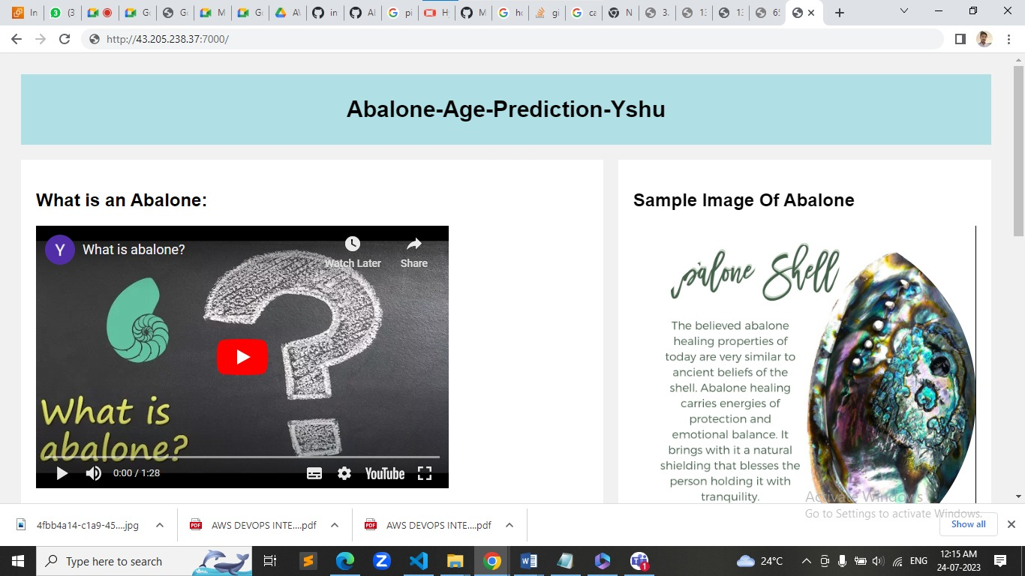
Out put :

Slide 9
THANK YOU .

